Slide 1
بسم الله الرحمن الرحيم
السلام عليكم ورحمة الله وبركاته

Slide 2
Data base final project
Team 6

Slide 3
Team 6 members:
Rehab ragab
Gehad safwat
Ahmed atef
Abdelrahman
Loai mansour

Slide 4
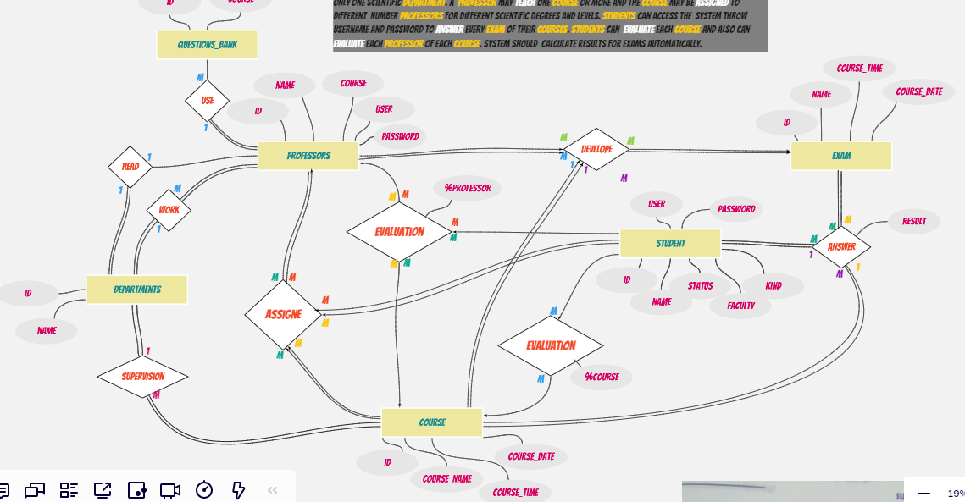
ER Drawing (Entities & relations with their attributes).

Slide 5
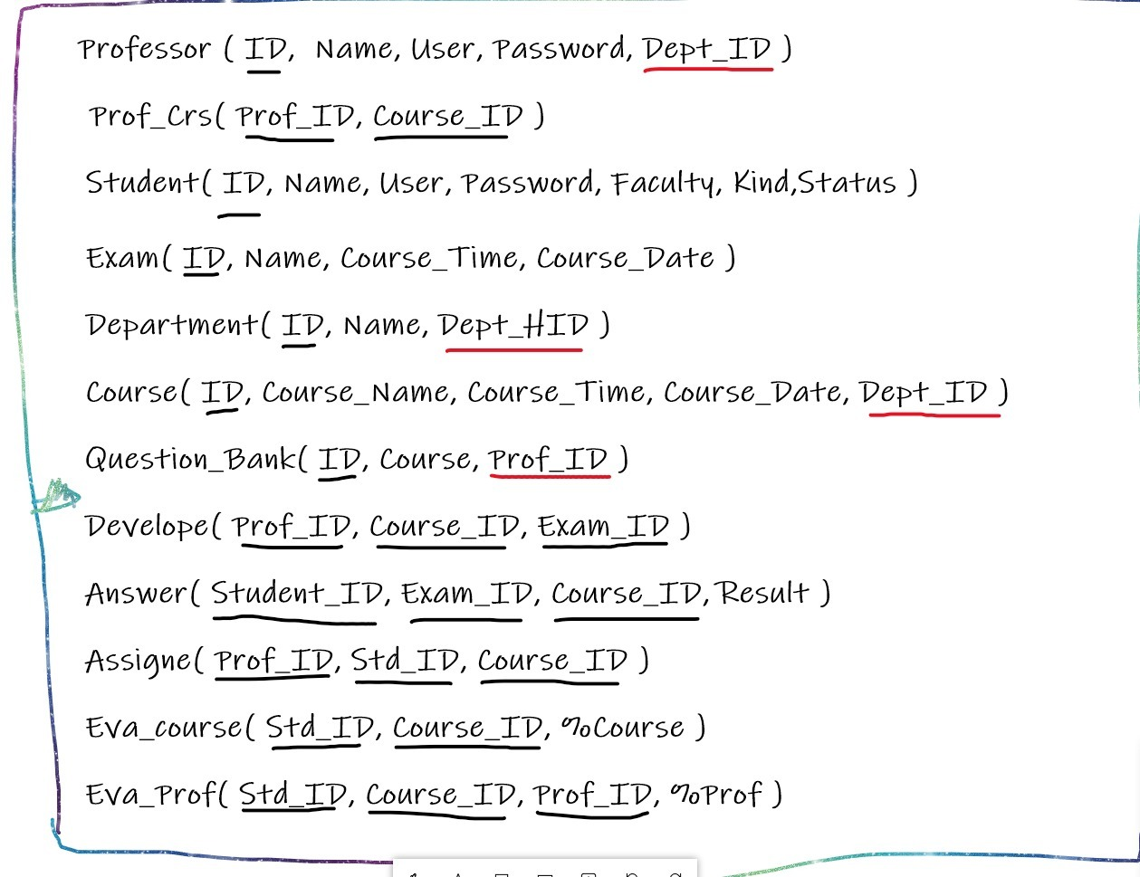
How we converted the ‘er’ to mapping with normalization.

Slide 6
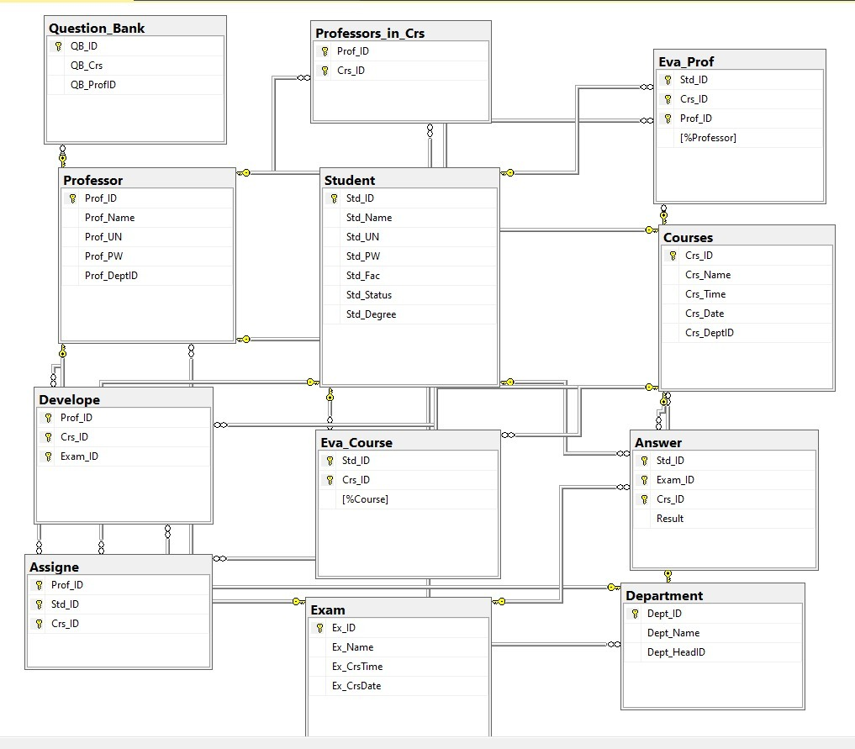
Our hard work in the Sql server (how we designed tables and connect them together).

Slide 7
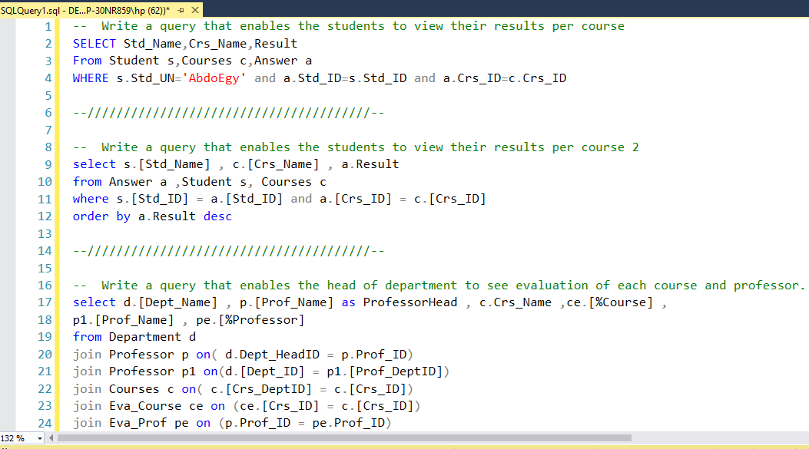
Finally the queries of the tasks.

Slide 8
Hope you like it sir . . . ☺

Slide 9
fin

